Slide 1
Introduction to AWS
Dr. Noman Islam

Slide 2
Introduction
AWS provides on-demand delivery of IT resources via the Internet on a secure cloud services platform, offering compute power, storage, databases, content delivery, and other functionality to help businesses scale and grow

Slide 3
Why AWS?
Using AWS resources instead of your own is like purchasing electricity from a power company instead of running your own generator, and it provides the key advantages of cloud computing:
Capacity exactly matches your need, you pay only for what you use, economies of scale result in lower costs,
and the service is provided by a vendor experienced in running large-scale networks.

Slide 4
Global Infrastructure
AWS serves over one million active customers in more than 190 countries
AWS provides a highly available technology infrastructure platform with multiple locations worldwide
These locations are composed of regions and Availability Zones

Slide 5
Regions and Zones
Each region is a separate geographic area. Each region has multiple, isolated locations known as Availability Zones.
AWS enables the placement of resources and data in multiple locations. Resources aren’t replicated across regions unless organizations choose to do so.
Each region is completely independent and is designed to be completely isolated from the other regions
Availability Zones in a region are connected through low-latency links

Slide 6
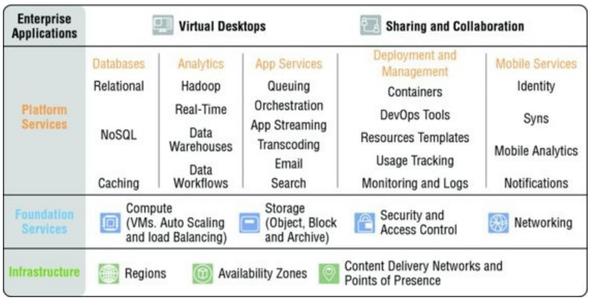

Slide 7
Accessing the platform
To access AWS Cloud services, you can use the AWS Management Console, the AWS Command Line Interface (CLI), or the AWS Software Development Kits (SDKs).

Slide 8
AWS Management Console
The AWS Management Console is a web application for managing AWS Cloud services.
The console provides an intuitive user interface for performing many tasks. Each service has its own console, which can be accessed from the AWS Management Console.
The console also provides information about the account and billing.

Slide 9
Command line interface
The AWS Command Line Interface (CLI) is a unified tool used to manage AWS Cloud services. With just one tool to download and configure, you can control multiple services from the command line and automate them through scripts.

Slide 10
Software Development Kits
The AWS Software Development Kits (SDKs) provide an application programming interface (API) that interacts with the web services that fundamentally make up the AWS platform.
The SDKs provide support for many different programming languages and platforms to allow you to work with your preferred language.
While you can certainly make HTTP calls directly to the web service endpoints, using the SDKs can take the complexity out of coding by providing programmatic access for many of the services.

Slide 11
Compute and Networking Services
AWS provides a variety of compute and networking services to deliver core functionality for businesses to develop and run their workloads.
These compute and networking services can be leveraged with the storage, database, and application services to provide a complete solution for computing, query processing, and storage across a wide range of applications.
This section offers a high-level description of the core computing and networking services.

Slide 12
Amazon EC3
Amazon Elastic Compute Cloud (Amazon EC2) is a web service that provides resizable compute capacity in the cloud.
It allows organizations to obtain and configure virtual servers in Amazon’s data centers and to harness those resources to build and host software systems.
Organizations can select from a variety of operating systems and resource configurations (memory, CPU, storage, and so on) that are optimal for the application profile of each workload.

Slide 13
AWS Lambda
AWS Lambda is a zero-administration compute platform for back-end web developers that runs your code for you on the AWS Cloud and provides you with a fine-grained pricing structure.
AWS Lambda runs your back-end code on its own AWS compute fleet of Amazon EC2 instances across multiple Availability Zones in a region, which provides the high availability, security, performance, and scalability of the AWS infrastructure.

Slide 14
Auto Scaling
Auto Scaling allows organizations to scale Amazon EC2 capacity up or down automatically according to conditions defined for the particular workload

Slide 15
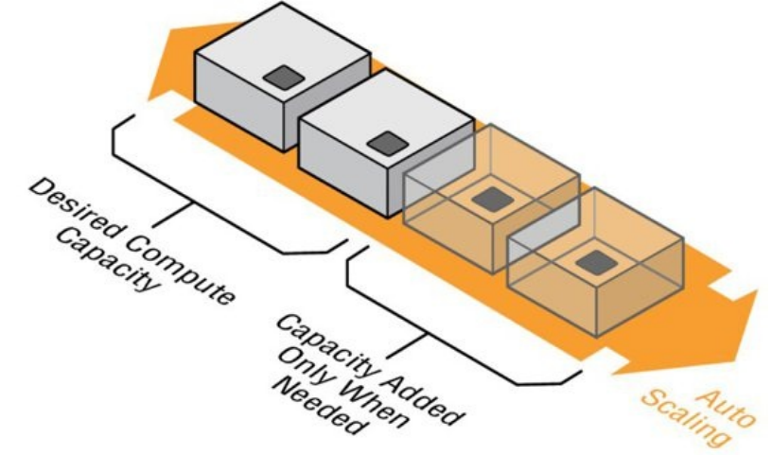

Slide 16
Elastic Load Balancing
Elastic Load Balancing automatically distributes incoming application traffic across multiple Amazon EC2 instances in the cloud.
It enables organizations to achieve greater levels of fault tolerance in their applications, seamlessly providing the required amount of load balancing capacity needed to distribute application traffic.

Slide 17
AWS Elastic Beanstalk
AWS Elastic Beanstalk is the fastest and simplest way to get a web application up and running on AWS.
Developers can simply upload their application code, and the service automatically handles all the details, such as resource provisioning, load balancing, Auto Scaling, and monitoring.
It provides support for a variety of platforms, including PHP, Java, Python, Ruby, Node.js, .NET, and Go

Slide 18
Amazon Virtual Private Cloud (Amazon VPC)
Amazon Virtual Private Cloud (Amazon VPC) lets organizations provision a logically isolated section of the AWS Cloud where they can launch AWS resources in a virtual network that they define.
Organizations have complete control over the virtual environment, including selection of the IP address range, creation of subnets, and configuration of route tables and network gateways.

Slide 19
AWS Direct Connect
AWS Direct Connect allows organizations to establish a dedicated network connection from their data center to AWS.
Using AWS Direct Connect, organizations can establish private connectivity between AWS and their data center, office, or colocation environment, which in many cases can reduce network costs, increase bandwidth throughput, and provide a more consistent network experience than Internetbased VPN connections.

Slide 20
Amazon Route 53
Amazon Route 53 is a highly available and scalable Domain Name System (DNS) web service.
It is designed to give developers and businesses an extremely reliable and cost-effective way to route end users to Internet applications by translating human readable names, such as www.example.com, into the numeric IP addresses, such as 192.0.2.1, that computers use to connect to each other.

Slide 21
Amazon Route 53 also serves as domain registrar, allowing you to purchase and manage domains directly from AWS.

Slide 22
Storage and Networking Service
AWS provides a variety of services to meet your storage needs, such as Amazon Simple Storage Service, Amazon CloudFront, and Amazon Elastic Block Store.
This section provides an overview of the storage and content delivery services.

Slide 23
Amazon Simple Storage Service (Amazon S3)
Amazon Simple Storage Service (Amazon S3) provides developers and IT teams with highly durable and scalable object storage that handles virtually unlimited amounts of data and large numbers of concurrent users.
Organizations can store any number of objects of any type, such as HTMLpages, source code files, image files, and encrypted data, and access them using HTTP-based protocols.

Slide 24
Amazon Glacier
Amazon Glacier is a secure, durable, and extremely low-cost storage service for data archiving and longterm backup.
Organizations can reliably store large or small amounts of data for a very low cost per gigabyte per month.
To keep costs low for customers, Amazon Glacier is optimized for infrequently accessed data where a retrieval time of several hours is suitable

Slide 25
Amazon Elastic Block Store (Amazon EBS)
Amazon Elastic Block Store (Amazon EBS) provides persistent block-level storage volumes for use with Amazon EC2 instances.
Each Amazon EBS volume is automatically replicated within its Availability Zone to protect organizations from component failure, offering high availability and durability

Slide 26
AWS Storage Gateway
AWS Storage Gateway is a service connecting an on-premises software appliance with cloud-based storage to provide seamless and secure integration between an organization’s on-premises IT environment and the AWS storage infrastructure

Slide 27
Amazon CloudFront
Amazon CloudFront is a content delivery web service. It integrates with other AWS Cloud services to give developers and businesses an easy way to distribute content to users across the world with low latency, high data transfer speeds, and no minimum usage commitments.
Amazon CloudFront can be used to deliver your entire website, including dynamic, static, streaming, and interactive content, using a global network of edge locations.

Slide 28
Requests for content are automatically routed to the nearest edge location, so content is delivered with the best possible performance to end users around the globe.

Slide 29
Database Services
AWS provides fully managed relational and NoSQLdatabase services, and in-memory caching as a service and a petabyte-scale data warehouse solution.
This section provides an overview of the products that the database services comprise.

Slide 30
Amazon Relational Database Service (Amazon RDS)
Amazon Relational Database Service (Amazon RDS) provides a fully managed relational database with support for many popular open source and commercial database engines.
It’s a cost-efficient service that allows organizations to launch secure, highly available, fault-tolerant, production-ready databases in minutes

Slide 31
Amazon DynamoDB
Amazon DynamoDB is a fast and flexible NoSQLdatabase service for all applications that need consistent, single-digit millisecond latency at any scale.
It is a fully managed database and supports both document and key/value data models.
Its flexible data model and reliable performance make it a great fit for mobile, web, gaming, ad-tech, Internet of Things, and many other applications.

Slide 32
Amazon Redshift
Amazon Redshift is a fast, fully managed, petabyte-scale data warehouse service that makes it simple and cost effective to analyze structured data.
Amazon Redshift provides a standard SQLinterface that lets organizations use existing business intelligence tools.

Slide 33
Amazon ElastiCache
Amazon ElastiCache is a web service that simplifies deployment, operation, and scaling of an in-memory cache in the cloud.
The service improves the performance of web applications by allowing organizations to retrieve information from fast, managed, in-memory caches, instead of relying entirely on slower, diskbased databases.
Amazon ElastiCache supports Memcached and Redis cache engines.

Slide 34
Management Tools
AWS provides a variety of tools that help organizations manage your AWS resources.
This section provides an overview of the management tools that AWS provides to organizations.

Slide 35
Amazon CloudWatch
Amazon CloudWatch is a monitoring service for AWS Cloud resources and the applications running on AWS.
It allows organizations to collect and track metrics, collect and monitor log files, and set alarms.

Slide 36
By leveraging Amazon CloudWatch, organizations can gain system-wide visibility into resource utilization, application performance, and operational health.
By using these insights, organizations can react, as necessary, to keep applications running smoothly.

Slide 37
AWS CloudFormation
AWS CloudFormation gives developers and systems administrators an effective way to create and manage a collection of related AWS resources, provisioning and updating them in an orderly and predictable fashion.
AWS CloudFormation defines a JSON-based templating language that can be used to describe all the AWS resources that are necessary for a workload.

Slide 38
Templates can be submitted to AWS CloudFormation and the service will take care of provisioning and configuring those resources in appropriate order

Slide 39
AWS CloudTrail
AWS CloudTrail is a web service that records AWS API calls for an account and delivers log files for audit and review.
The recorded information includes the identity of the API caller, the time of the API call, the source IP address of the API caller, the request parameters, and the response elements returned by the service.

Slide 40
AWS Config
AWS Config is a fully managed service that provides organizations with an AWS resource inventory, configuration history, and configuration change notifications to enable security and governance.
With AWS Config, organizations can discover existing AWS resources, export an inventory of their AWS resources with all configuration details, and determine how a resource was configured at any point in time.

Slide 41
These capabilities enable compliance auditing, security analysis, resource change tracking, and troubleshooting

Slide 42
Security and Identity
AWS provides security and identity services that help organizations secure their data and systems on the cloud.
The following section explores these services at a high level.

Slide 43
AWS Identity and Access Management (IAM)
AWS Identity and Access Management (IAM) enables organizations to securely control access to AWS Cloud services and resources for their users.
Using IAM, organizations can create and manage AWS users and groups and use permissions to allow and deny their access to AWS resources.

Slide 44
AWS Key Management Service (KMS)
AWS Key Management Service (KMS) is a managed service that makes it easy for organizations to create and control the encryption keys used to encrypt their data and uses Hardware Security Modules (HSMs) to protect the security of your keys.
AWS KMS is integrated with several other AWS Cloud services to help protect data stored with these services.

Slide 45
AWS Directory Service
AWS Directory Service allows organizations to set up and run Microsoft Active Directory on the AWS Cloud or connect their AWS resources with an existing on-premises Microsoft Active Directory.
Organizations can use it to manage users and groups, provide single sign-on to applications and services, create and apply Group Policies, domain join Amazon EC2 instances, and simplify the deployment and management of cloud-based Linux and Microsoft Windows workloads.

Slide 46
AWS Certificate Manager
AWS Certificate Manager is a service that lets organizations easily provision, manage, and deploy Secure Sockets Layer/Transport Layer Security (SSL/TLS) certificates for use with AWS Cloud services.
It removes the time-consuming manual process of purchasing, uploading, and renewing SSL/TLS certificates.

Slide 47
AWS Web Application Firewall (WAF)
AWS Web Application Firewall (WAF) helps protect web applications from common attacks and exploits that could affect application availability, compromise security, or consume excessive resources.
AWS WAF gives organizations control over which traffic to allow or block to their web applications by defining customizable web security rules.

Slide 48
Application Services
AWS provides a variety of managed services to use with applications.
Amazon API Gateway
Amazon Elastic Transcoder
Amazon Simple Email Service (Amazon SES)
Amazon Simple Workflow Service (Amazon SWF)
Amazon Simple Queue Service (Amazon SQS)

